Slide 1





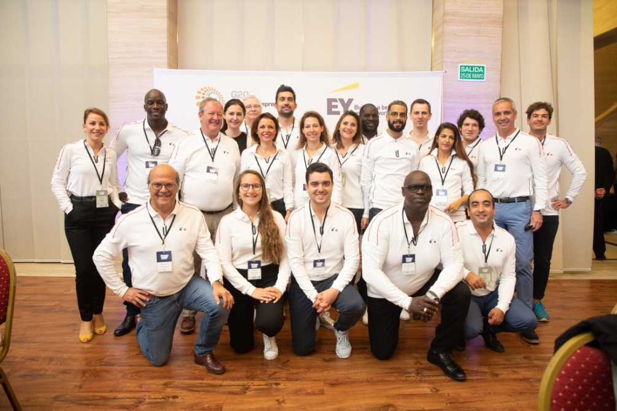
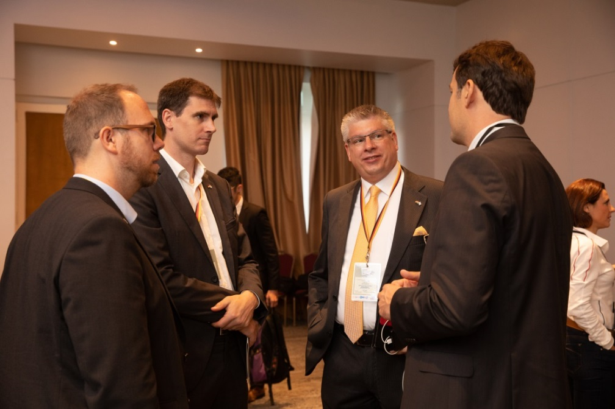


Slide 2


MENTORING
PROGRAMS
STARTUP
PROGRAMS
ACCELERATION
PROGRAMS
SCALEUP
PROGRAMS
MENTORING
PROGRAMS
ACCELERATION
PROGRAMS

Slide 3





